Slide 1


Technology for Tomorrow
Intro to Google Drive Part 1
Carly Stine
Program Manager

Slide 2

What We’ll Cover, and Why
How to:
Why:
Make a word document, excel spreadsheet, and more in Google Drive | Saving media in Google Drive means that you aren’t using up storage space on a flash drive or other device (a cheaper option)
Share the media/folders you’ve created | So that multiple people can contribute to or view media
Make folders in Google Drive | So you can more easily navigate your media/keep things organized
Duplicate media | So that you can have multiple drafts
Access media shared with you | So you can view and contribute to other media

Slide 3
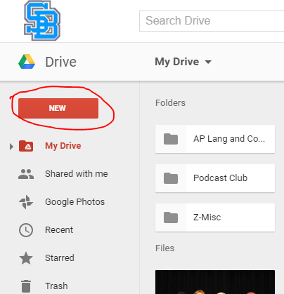
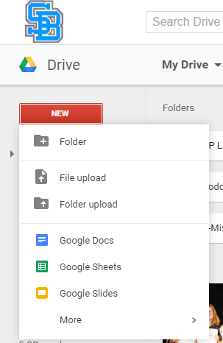
Creating Media
Go to the left-hand side of the screen once Google Drive is opened

Slide 4
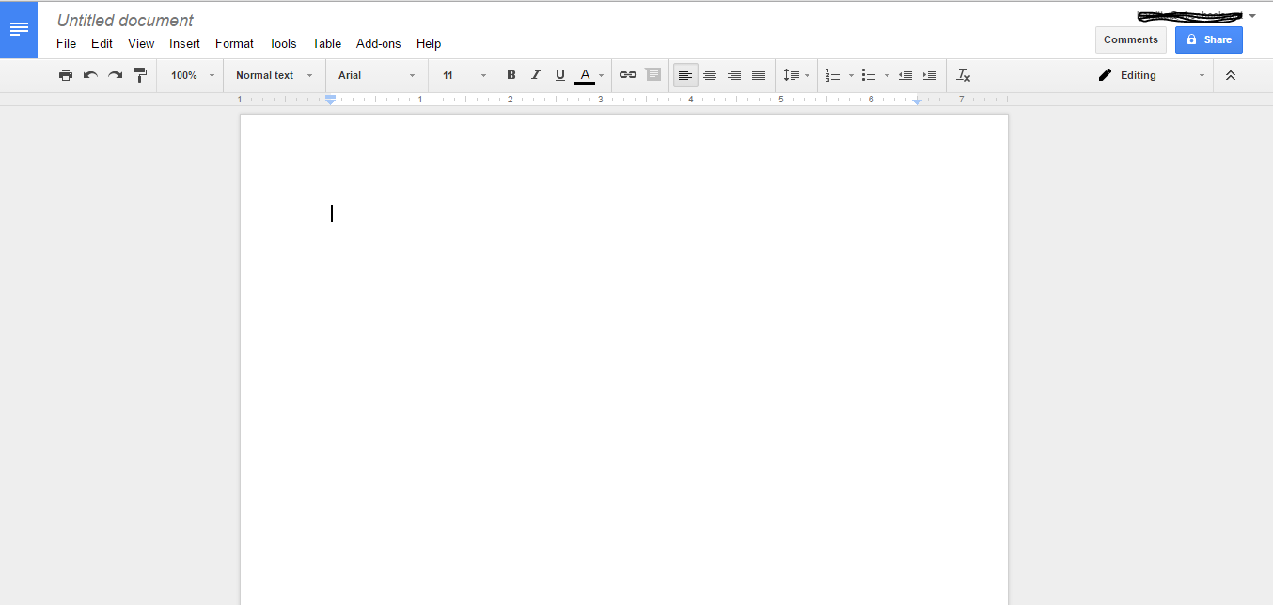
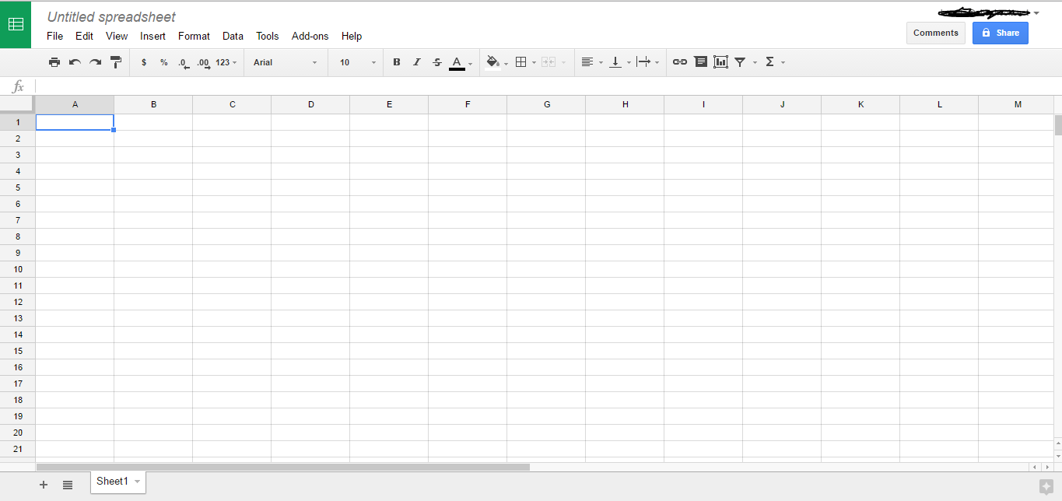
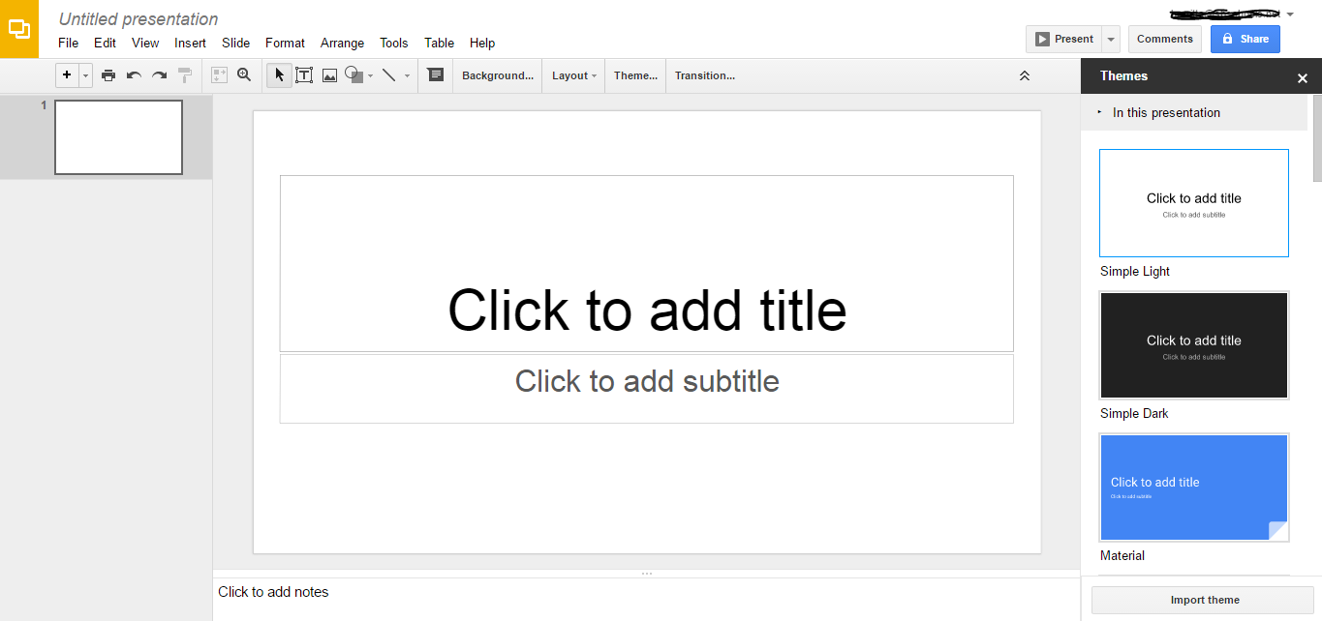
Google Docs
(for writing)
Google Sheets
(for recording data, doing calculations)
Google Slides
(for making presentations)

Slide 5
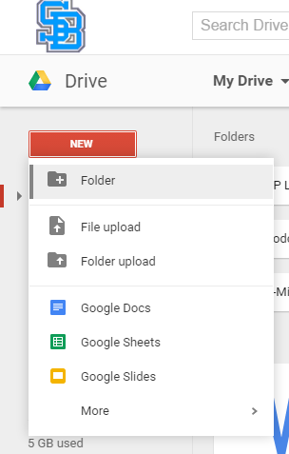
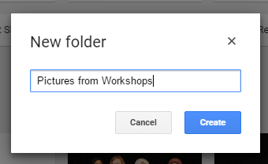
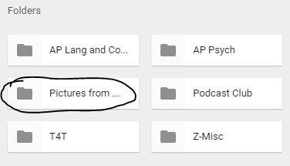
Making Folders/Organizing Your Media
2. Name it
Here it is in your drive!
1. Click on “New,” then “Folder”
Rename it at any point by right-clicking on it!

Slide 6
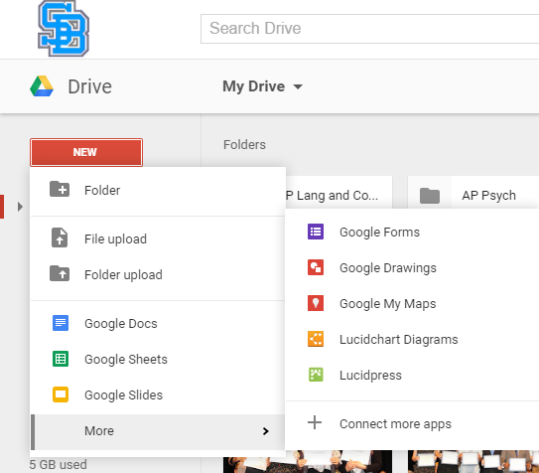
More Media Options

Slide 7

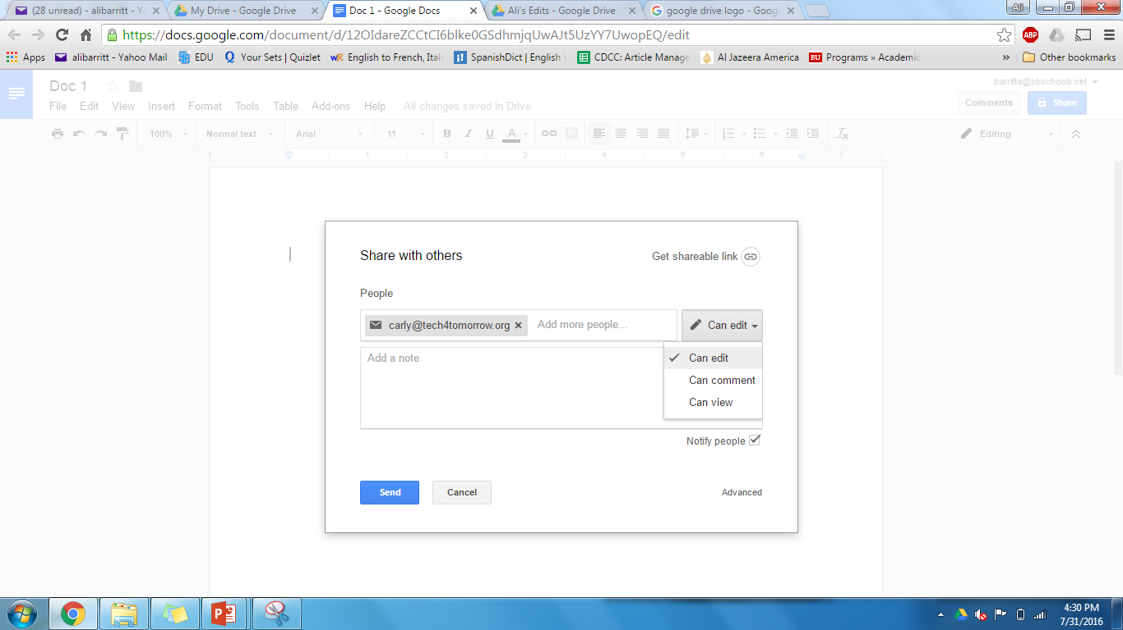
Share Media
To allow others to view or contribute to your media
2. After clicking on the “Share” button, this window should pop up, allowing you to add the email addresses of the people you’d like to share the media with
1. No matter what kind of media you make (word document, spreadsheet…etc.), this button should be in the upper right-hand corner
Here is where you can describe what it is you’re sending to your recipients
Hey Carly, here’s the agenda for tomorrow’s meeting that I was telling you about! Give me your feedback.

Slide 8
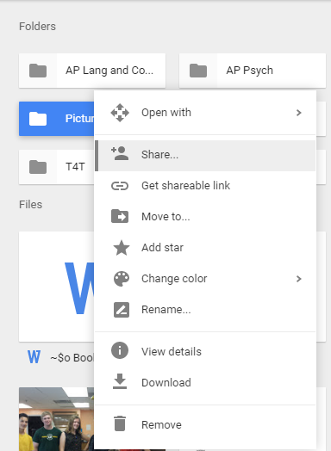
Sharing Folders
YOU MUST REMEMBER:
Sharing a FOLDER with a person means that they’ll be able to see EVERYTHING in the folder and be able to edit, comment on, and/or view (depending on what you’ve allowed them to do) ALL those files.
Hey Carly, can you take a peek at some of these pictures? I’m not sure which ones to keep. Let me know.
Which will bring you to this window again
Right click on the folder, then click on “Share”

Slide 9
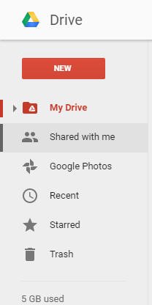
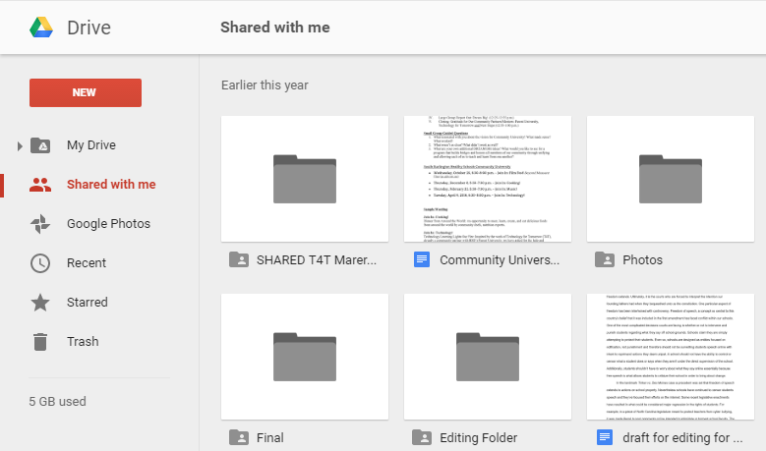
Accessing Media Shared with You
Click on “Shared with me” on the left-hand side of the screen
And voila! You can see everything that you’ve been given permission to view, comment on, and/or edit

Slide 10
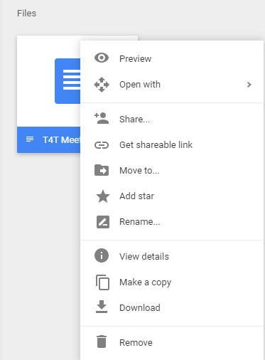
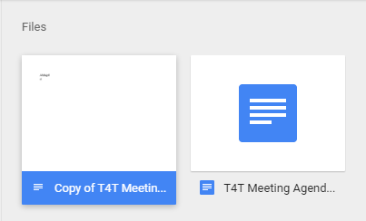
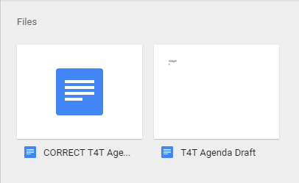
Duplicate Media (if you’d like to have multiple drafts)
COPY
COPY
Now you have a copy of your original file
And maybe you’ll do some work on the copy, then rename the files
Right click on the file you’d like to duplicate, then click “Make a copy”

Slide 11
Your Turn!
create a Google Drive account or login with your Gmail
create a document
upload a document
share a document with someone else
download the app

Slide 12

Thank You for Joining Us!
For more information, please visit www.tech4tomorrow.org
Questions? Workshop requests?
E-mail info@tech4tomorrow.org
Visit our Resource page at
www.tech4tomorrow.org/resources
Follow us on Facebook at Technology for Tomorrow
Special thanks to our partner:

