Slide 1


Technology for Tomorrow
Intro to Google Drive Part 2
Carly Stine
Program Manager

Slide 2

What We’ll Cover, and Why
How to:
Why:
Move media and folders | So that it’s easier to navigate your media
Download media to your computer | So that you can save a version on your computer, transfer a file to a storage device
Delete and recover files | So you don’t waste Google Drive storage space, and so you can recover accidentally deleted files
Search for files | So you can easily access a certain file

Slide 3
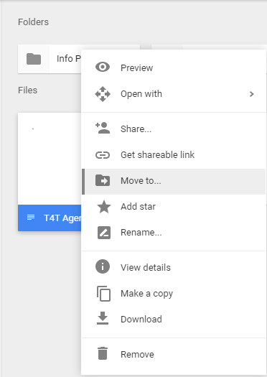
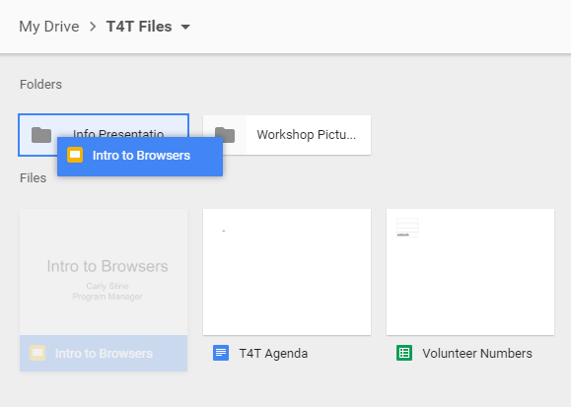
Move Media & Folders
One option is to drag and drop files into a folder
Or you could right-click on the file, and click on “Move to…”

Slide 4
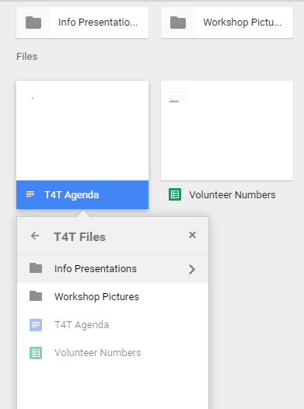
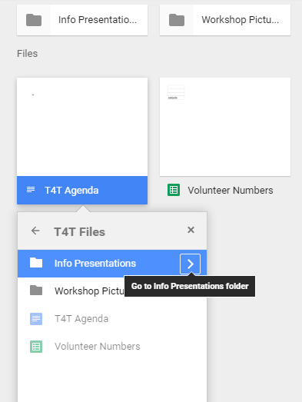
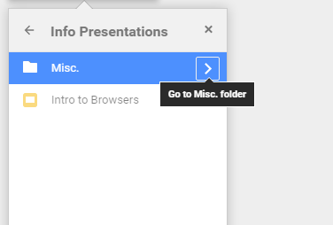
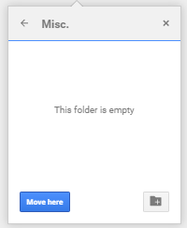
Here’s the folder you want, so click on the arrow next to its name to open it , then click “Move Here”
This
or
This
Then you can click on the folder you’d like to move the file to
And if there’s a folder within a folder, you can click on the arrow next to the name of the folder that contains the folder you want to add the file to

Slide 5
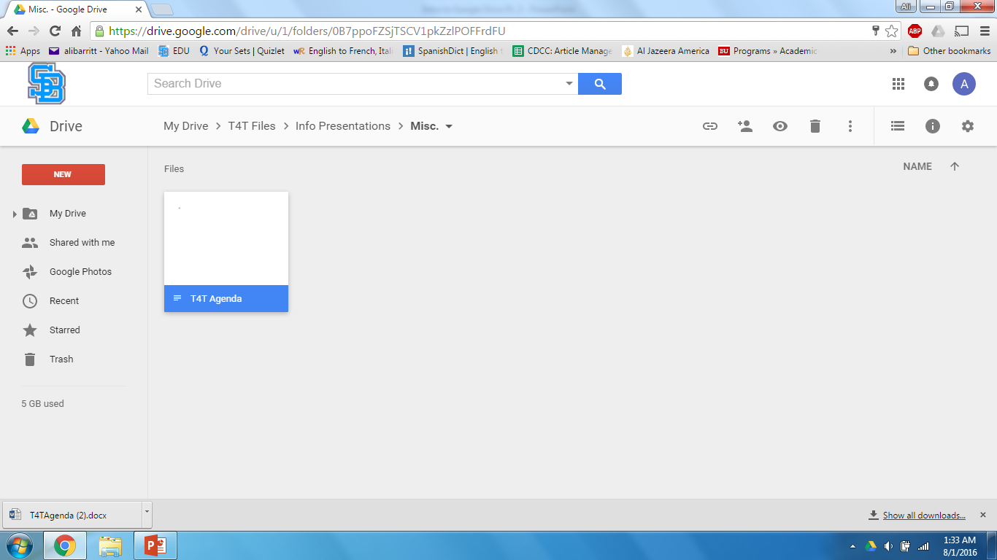
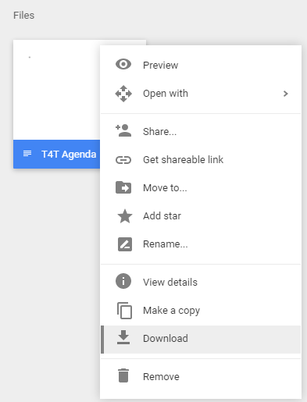
Download Media
Right click on the file you’d like to download, then click “Download”
The downloaded file will then appear at the bottom of your screen.

Slide 6

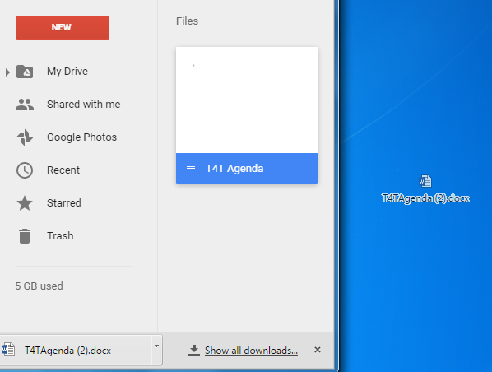
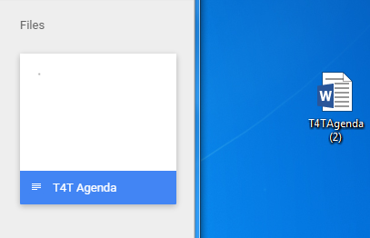
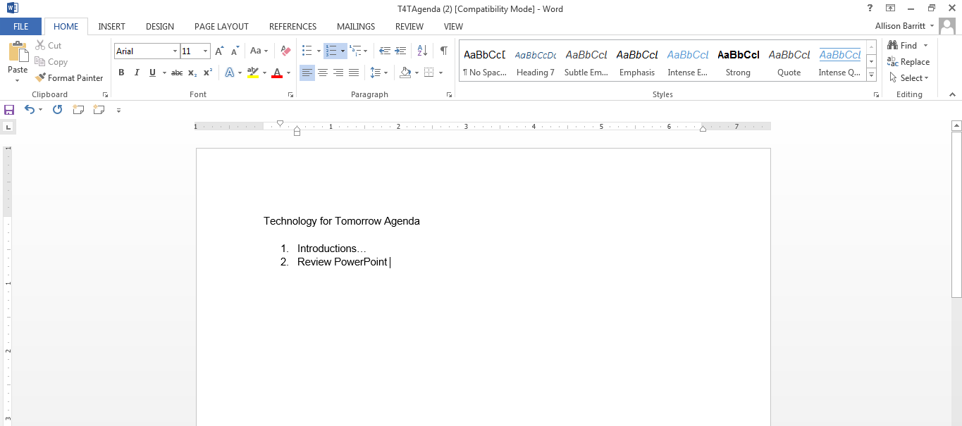
The file can now be moved onto a flash drive or other storage device if so desired
(by dragging and dropping)
2. The file is now on your desktop
1. You can press the left clicker down and drag and drop the file to your desktop
3. And if you click on it, it will now open in the program on your computer that deals with that type of media file

Slide 7
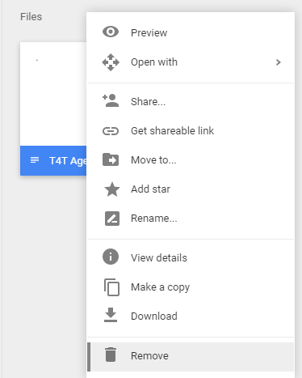
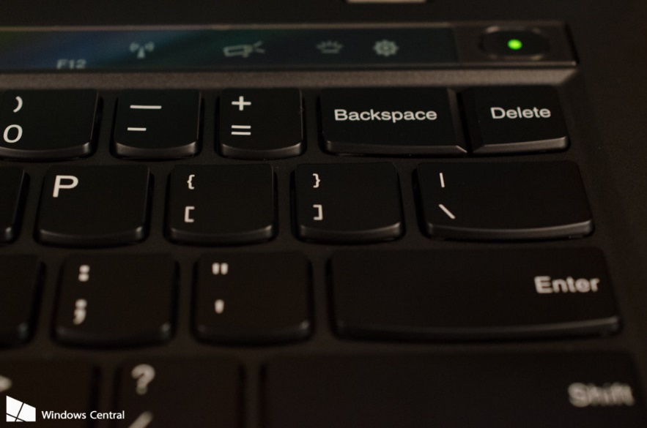

Delete Files
Click on a file, then click on your “Delete” key on your keyboard
Or right click on the file, then click “Remove”

Slide 8
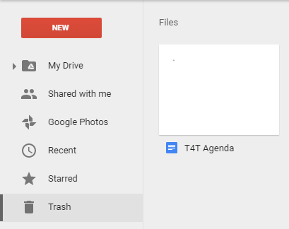
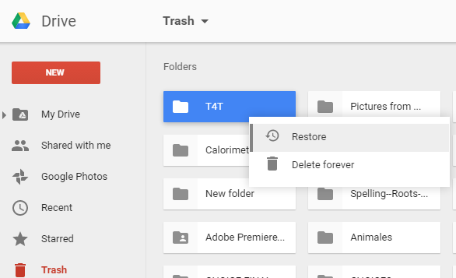
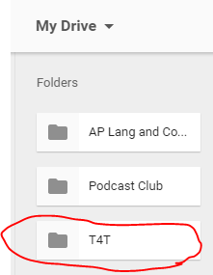
Recover Deleted Files (when you accidentally delete something)
3. The file will now appear in your drive
1. Click on “Trash” in the left-hand corner
2. Choose the file or folder you’d like to restore, right click on it, then click “Restore”

Slide 9
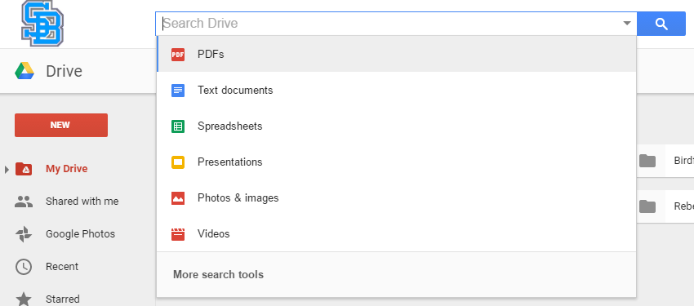
Searching for Files
You can search all of your drive for a specific file using keywords.
You can choose what file type you’re looking for to narrow your search

Slide 10
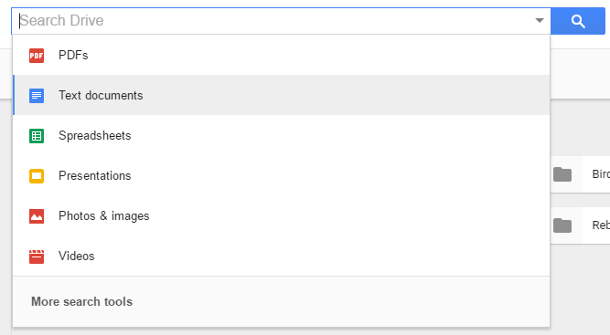
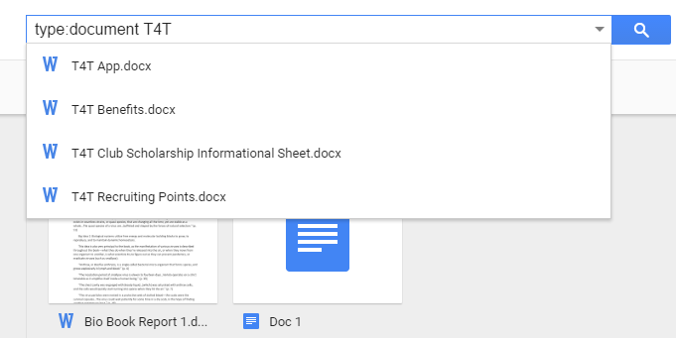
I’ve started a search using the keyword “T4T”
If you click on “Text documents,” you’ll be searching for a text document
All of these results are Google word documents

Slide 11

Thank you!
For more information, please visit tech4tomorrow.org
Questions? E-mail info@tech4tomorrow.org
Thank you for joining us!
Like us on Facebook! @Technology for Tomorrow
Visit www.tech4tomorrow.org/calendar-of-events/ for upcoming workshops
Special thanks to our partner:

